Slide 1
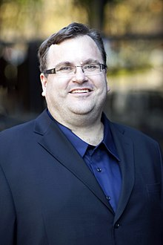
REID HOFFMAN (the co-founder of LinkedIn.)
"Networking is about establishing relationships that create value for all parties involved."

Slide 2
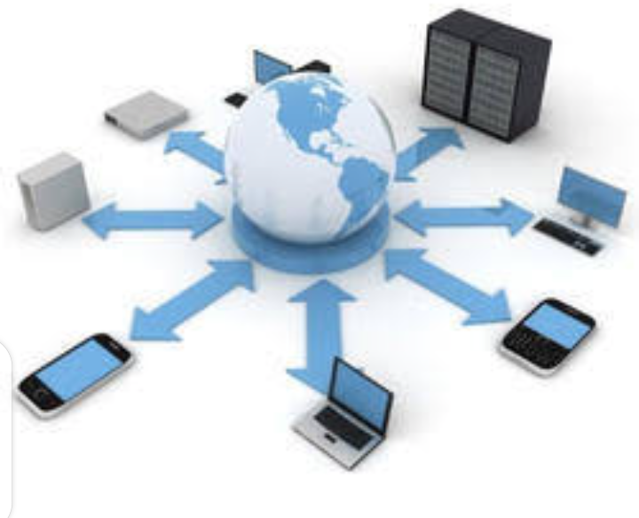
COMPUTER NETWORK
PRESENTER : IRFAN ALI QURESHI

Slide 3
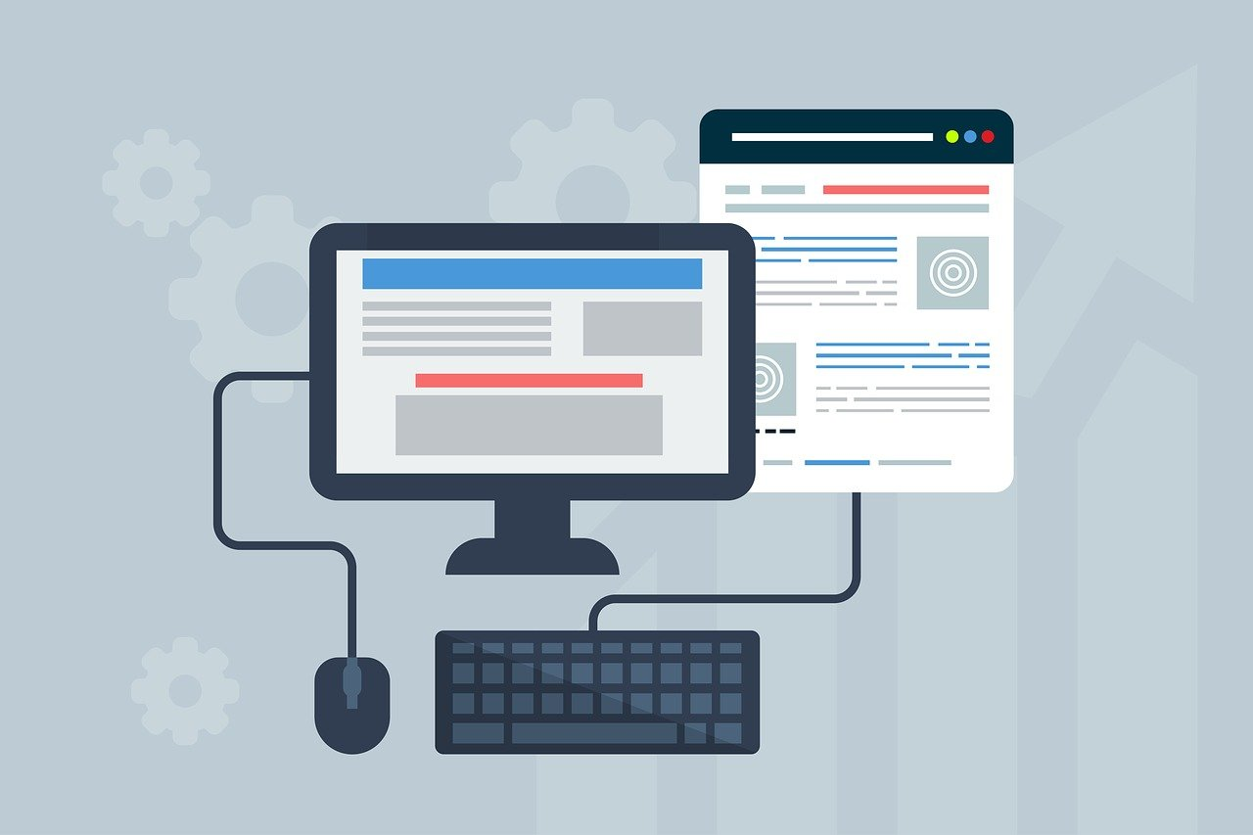
WELLCOME:

Slide 4

What will we learn in this presentation ?
Networking definition
Use of networking
Networking types
How to set a
computer network
5. How share data
through LAN networking

Slide 5
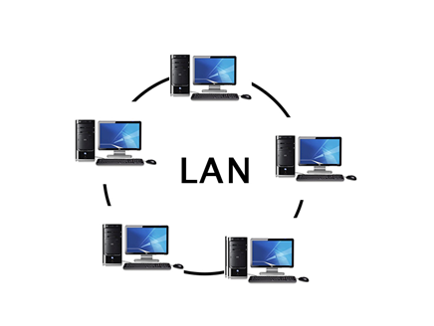
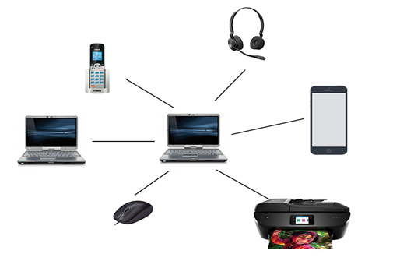
What is networking?
It is a system in which two or more than two computer are connected to each other to share INFORMATION and RESOURCES by either WIRED and WIRELESS media system.

Slide 6
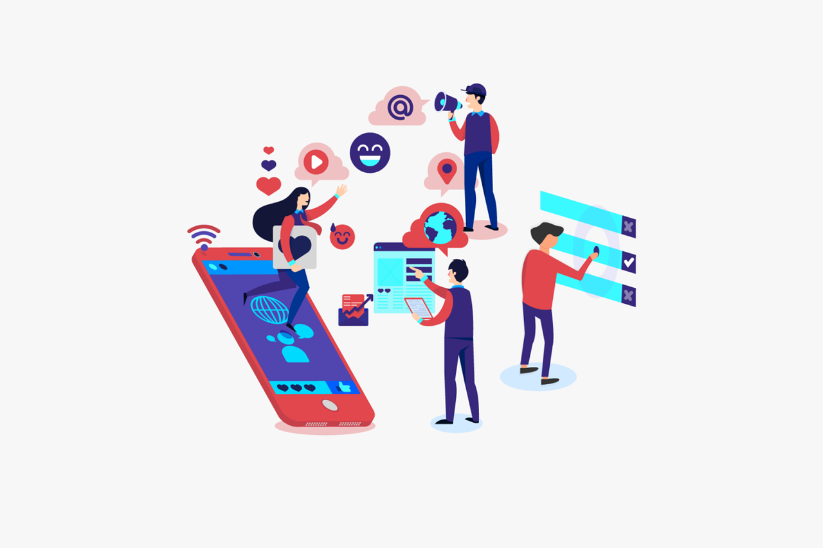
USE OF NETWORKING:
We use various technologies in our daily life such as email, instant messaging, online chat voice and video telephone calls , sending money ,browsing and shopping online.
These all our activities are possible due to networking.

Slide 7
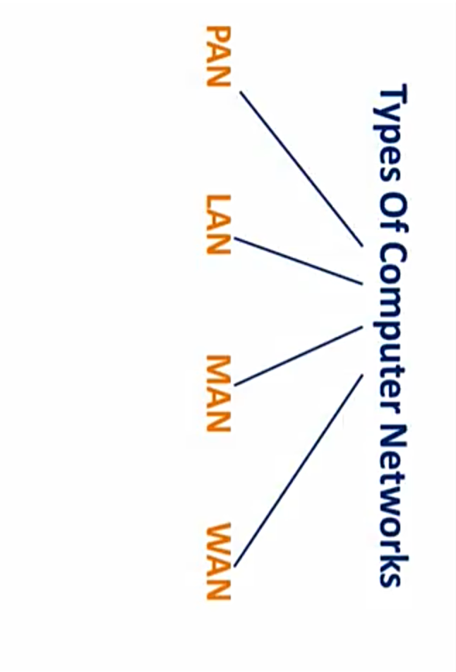
TYPES OF NETWORKING?
Following are the well known types of Network.

Slide 8
1) PAN (personal area network)
It is a smallest network which is very personal to a user.
Range 10 meters
Examples: keyboard ,mouse ,printer , scanner, Bluetooth ,zapya and tv remotes….

Slide 9
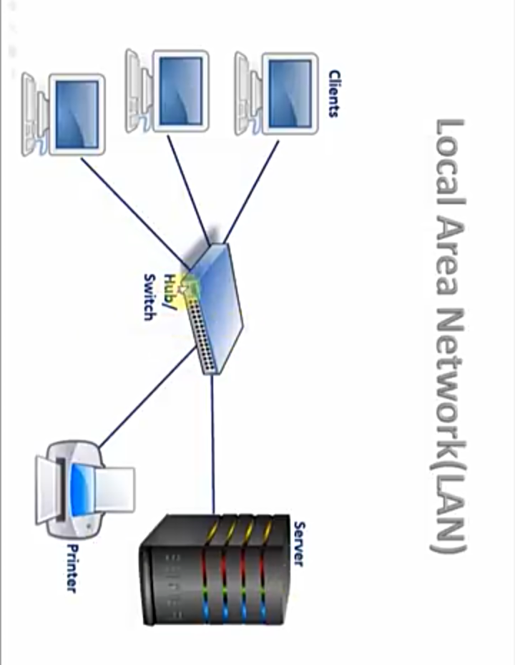
2) LAN (local area network)
In LAN computer network computer are spinned inside a building and operated under single administrative system
It is used in organization ,offices ,schools ,colleges and universities.
Wired and wireless or both
For example : WIFI and intranet etc.

Slide 10
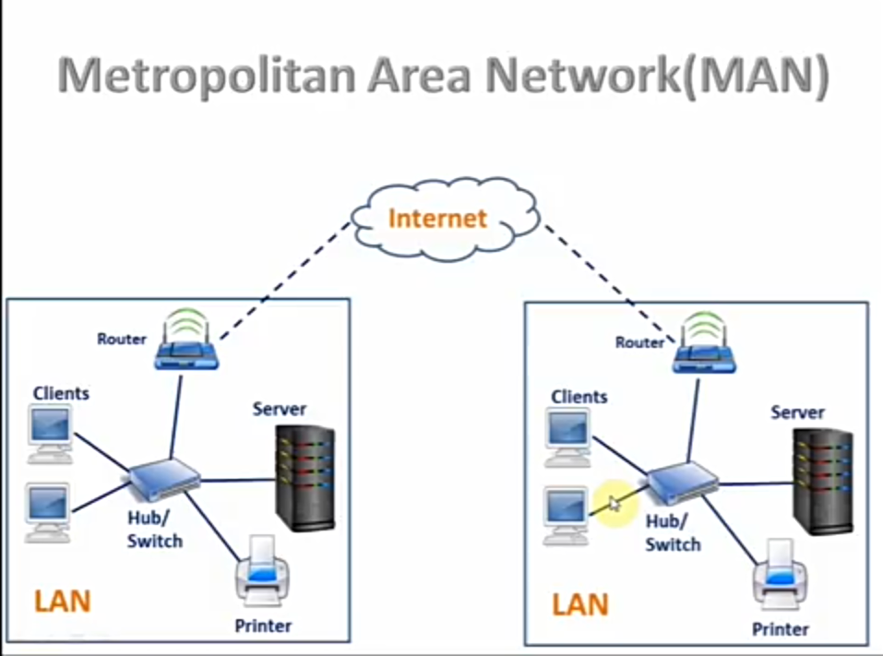
3) MAN (metropolitan area network)
This computer network expands throughout a city such as cable tv, landline telephone network etc.
It is group of LAN networks.

Slide 11
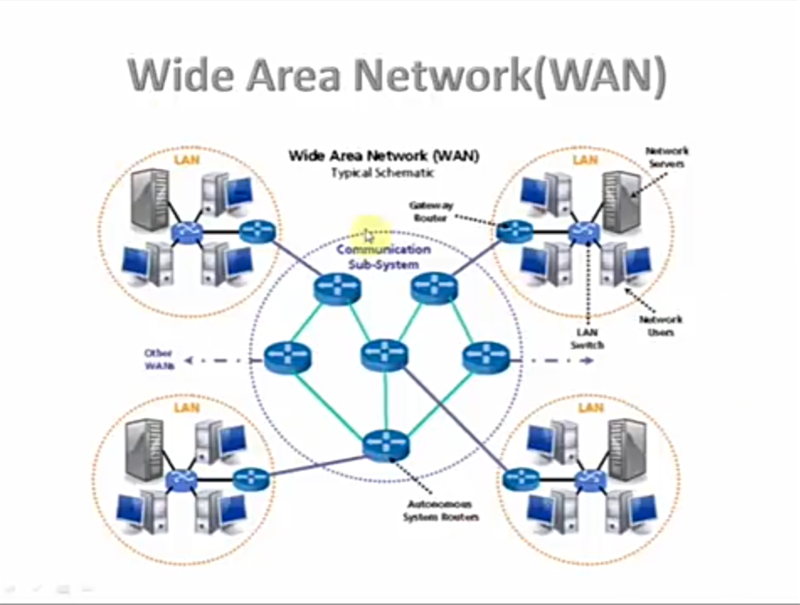
4) WAN (wide area network)
WAN is used for communication b/w devices of a large geographical areas such as countries or continents by using satellites and cables systems.
WAN can contains multiples small networks such as LAN or MAN.

Slide 12

HOW TO SET COMPUTER NETWORK???

Slide 13
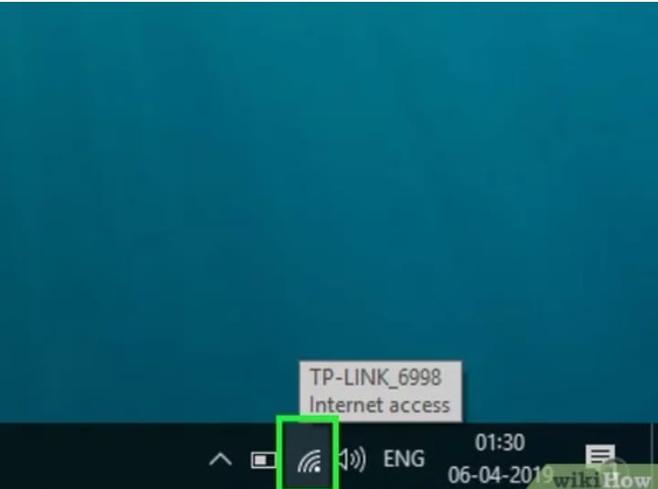
Click on wi fi icon to connect with WAN network:

Slide 14
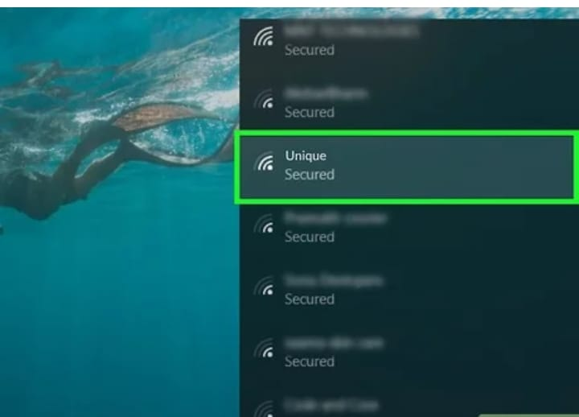
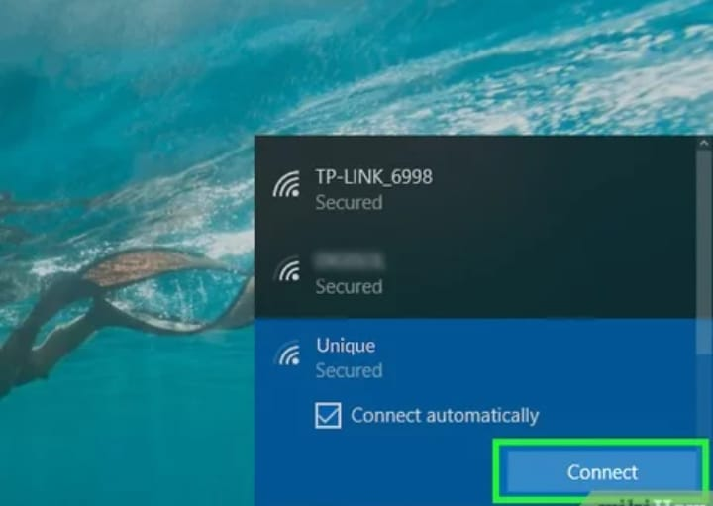
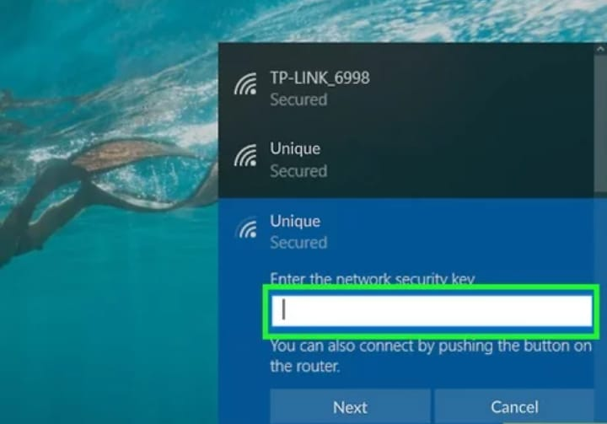
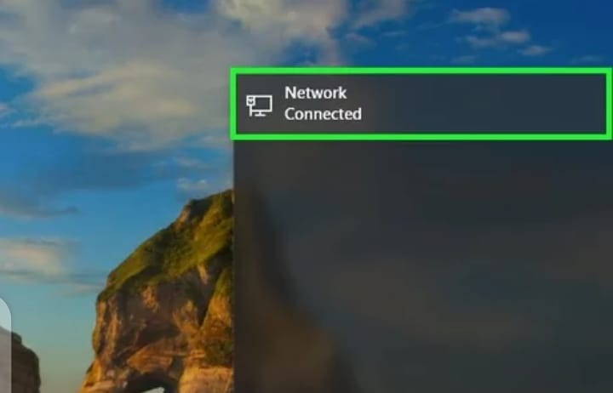
01
02
03
04

Slide 15
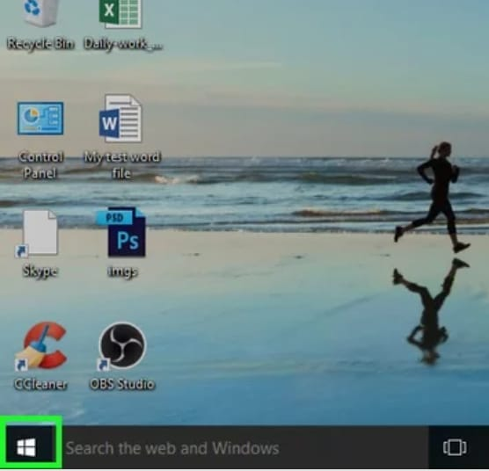
Connect other computers in a LAN network through the internet.

Slide 16
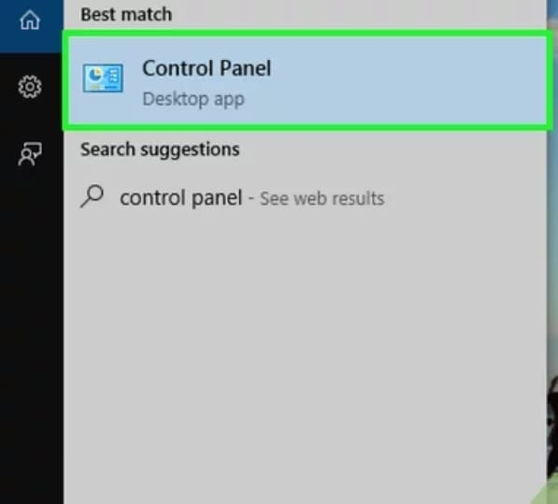
CONTROL PANEL:

Slide 17
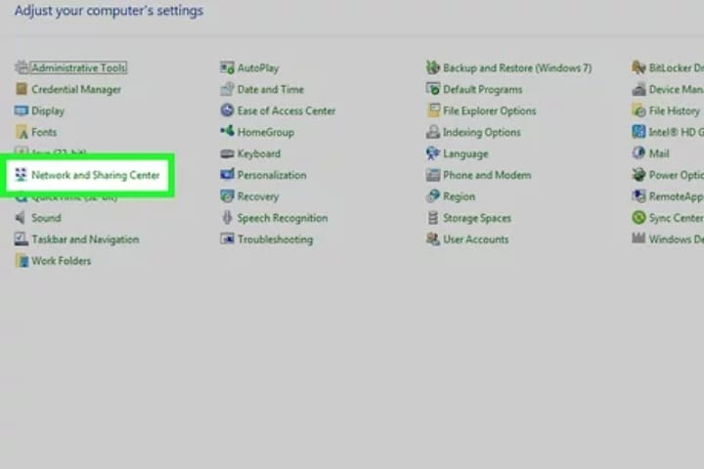
CLICK ON NETWORK SHARING :

Slide 18
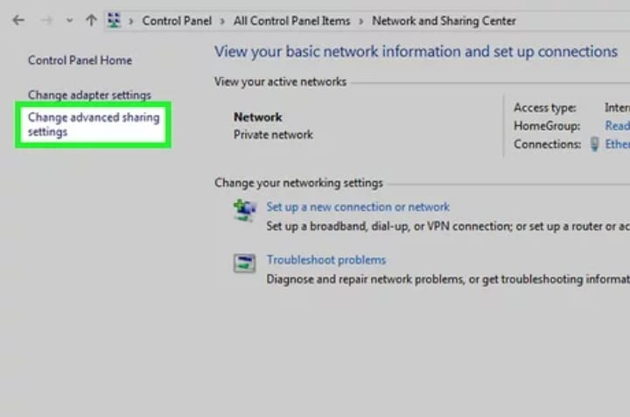
ADVANCE SHARING SETTING:

Slide 19
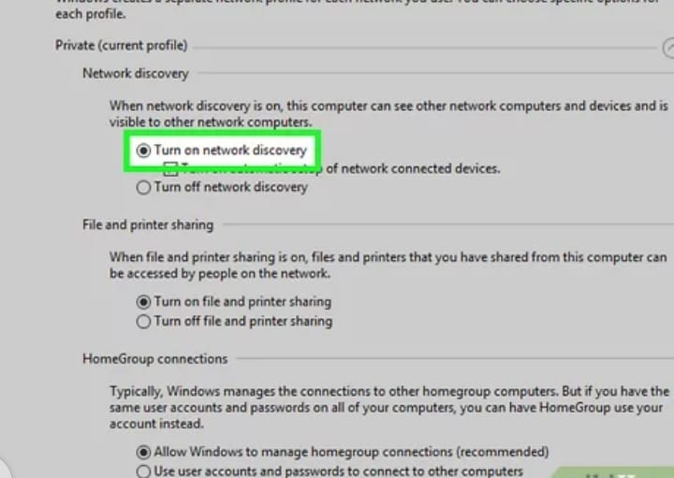
TURN ON NETWORK DISCOVERY:

Slide 20
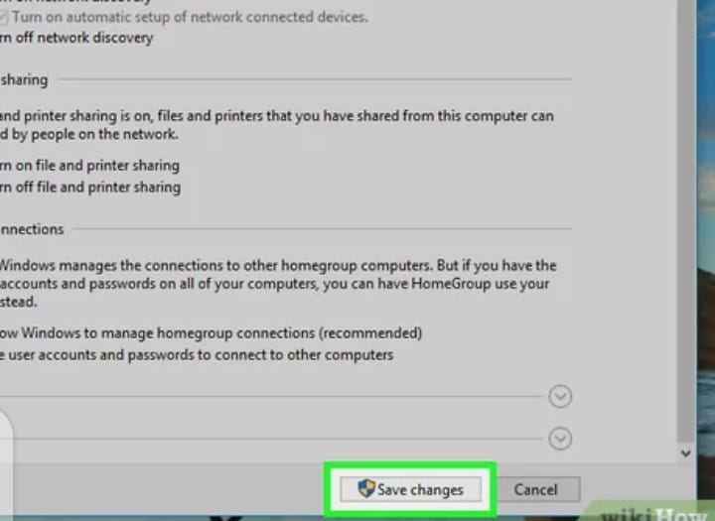
SAVE CHANGES

Slide 21
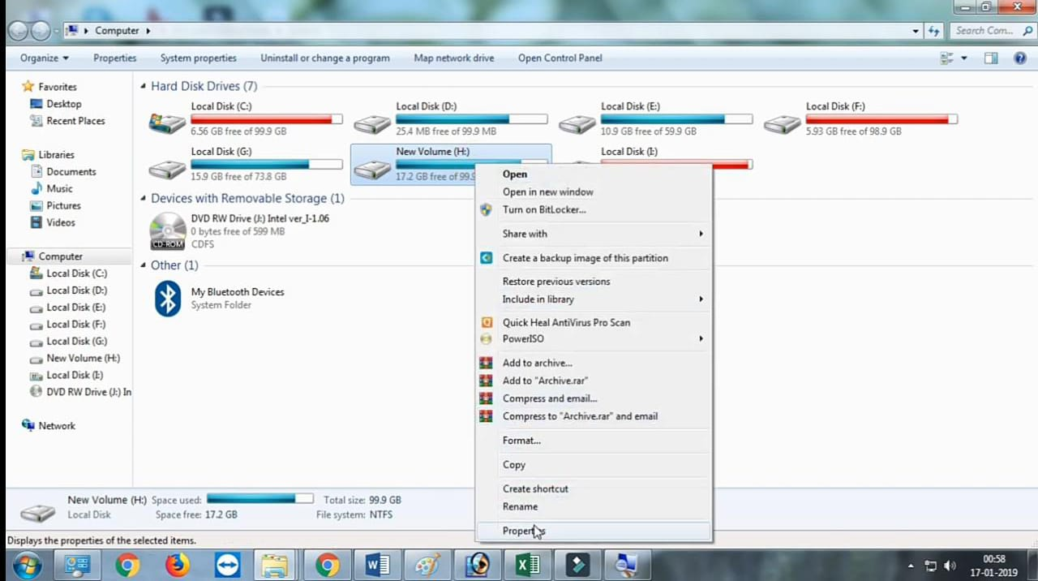
HOW TO SHARE DATA OR RESOURCES??

Slide 22
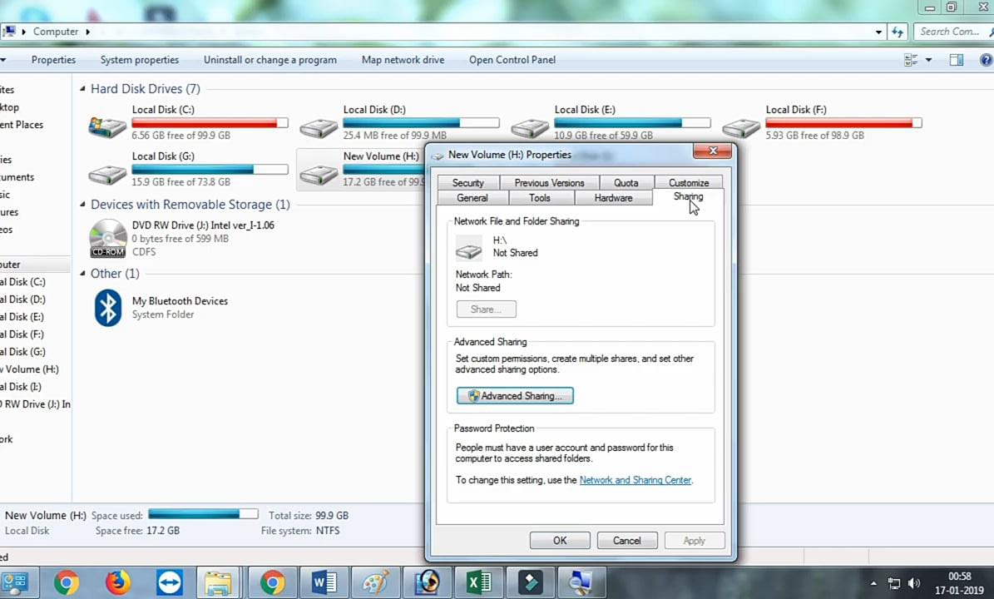
CLICK ON ADVANCE SHARING OPTION:

Slide 23
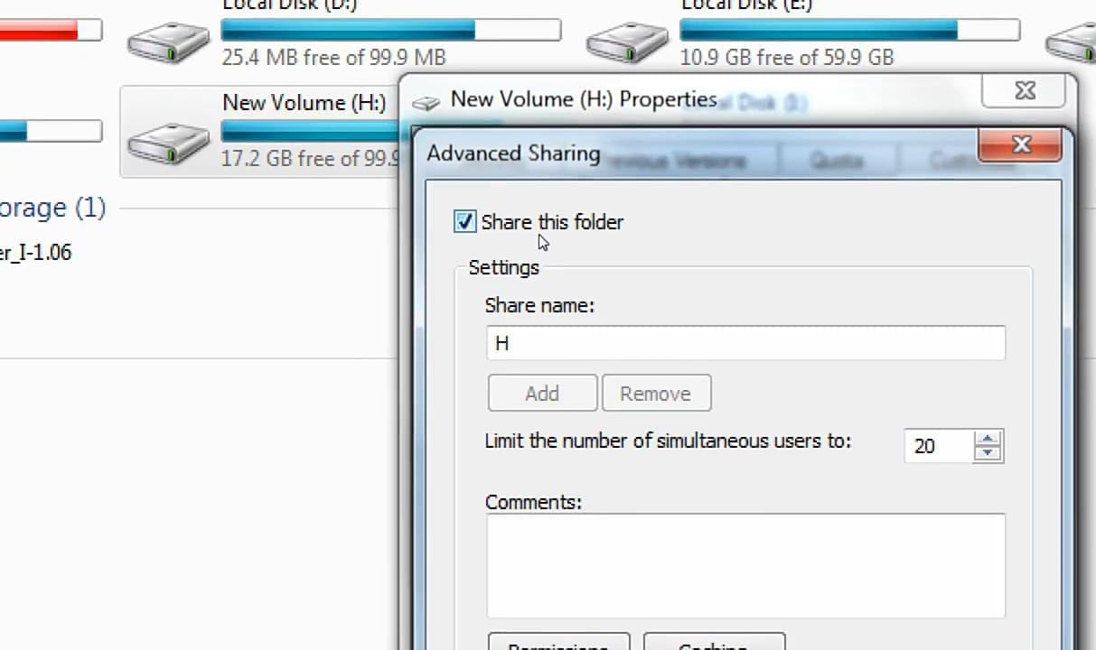
CLICK ON SHARE THIS FOLDER:

Slide 24
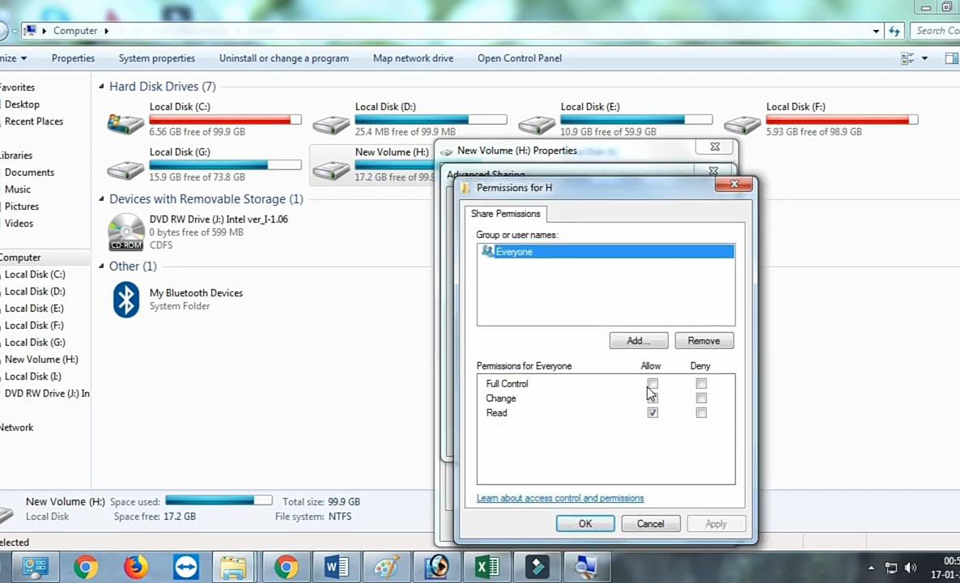
GIVE THE PERMENTION:

Slide 25
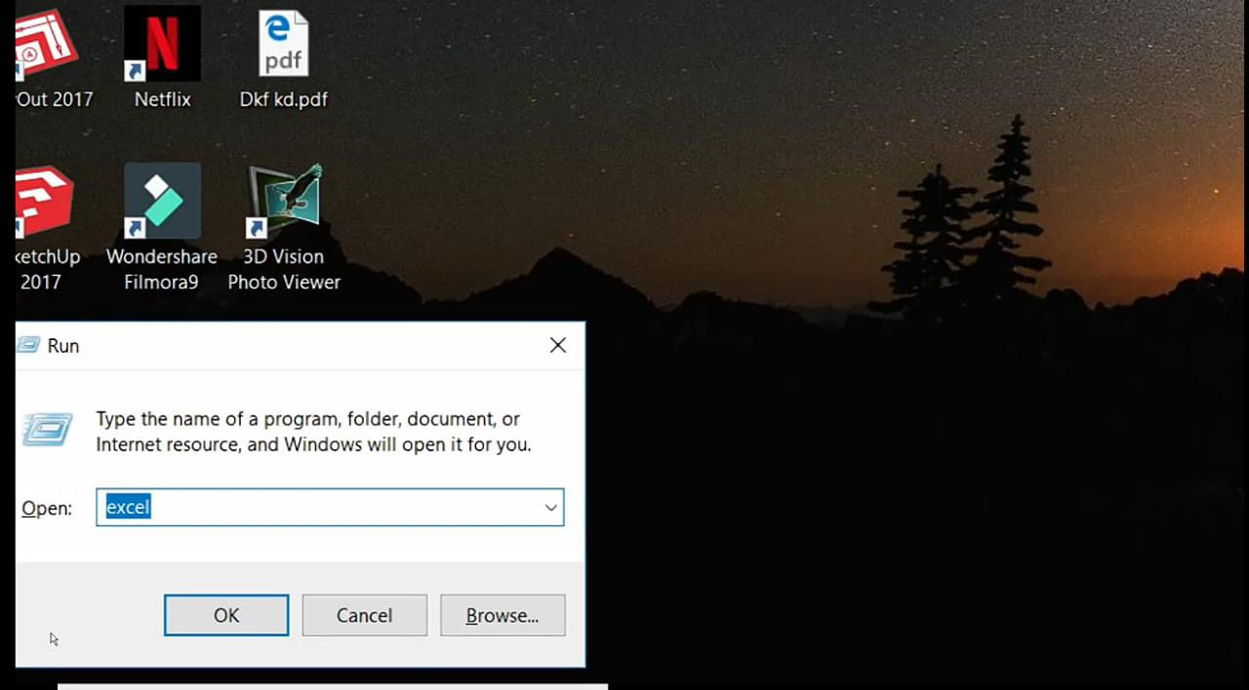
HOW TO ACCESS FROM OTHER INFORMATION:

Slide 26
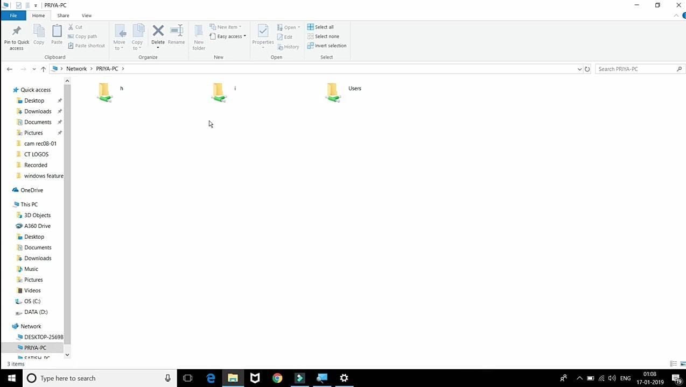
These are the files and folders of that computer in this computer which are shared.

Slide 27
IMPORTANT POINTS :
We can access shared computer by its name and IP address BECAUSE computers are connected through internet.
It is necessary that all the computers must be on same router.

Slide 28
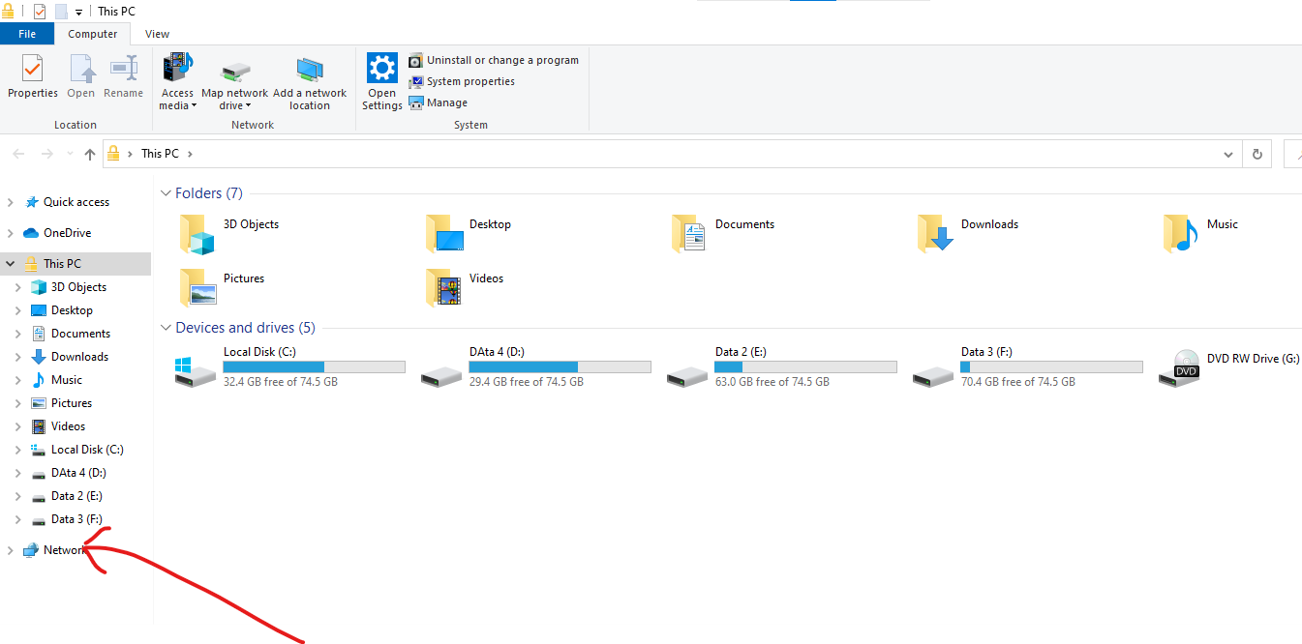
ANOTHER WAY TO FIND NETWORK:

Slide 29

Disadvantages of NETWORKING: In my point there are two major disadvantages of networking.
1)Networking provide a link to the hacker to hack data..

Slide 30

2) The human spend lot of time on computers because of networking so they waste their time in extra activities and health…

Slide 31



